Slide 2
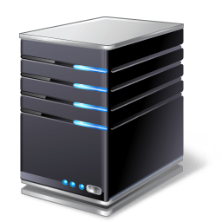


Identity
Your Name
I am ….
Username
Identification Number
Notes:
.

Slide 3
Authentication
Password
Prove it……
Fingerprint
Smartcard
Notes:
.

Slide 4

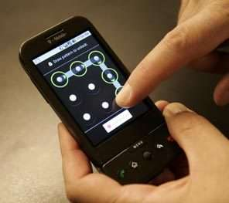
Authentication Factors
Something you know
Something you can do
Someone you know
Knowledge-based authentication
Static KBA
Dynamic KBA
Password
PIN
Q&A
Notes:
Shared Questions and Answers are a form of Static Knowledge-based authentication (KBA)
The client selects the questions and answers beforehand
Dynamic Knowledge-based Authentication – Client does not know the questions beforehand and relies on an identify verification service (last four of your social, email with a portion blurred out)
These identity verification providers

Slide 5
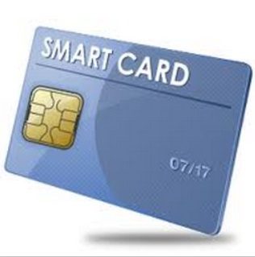
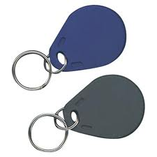
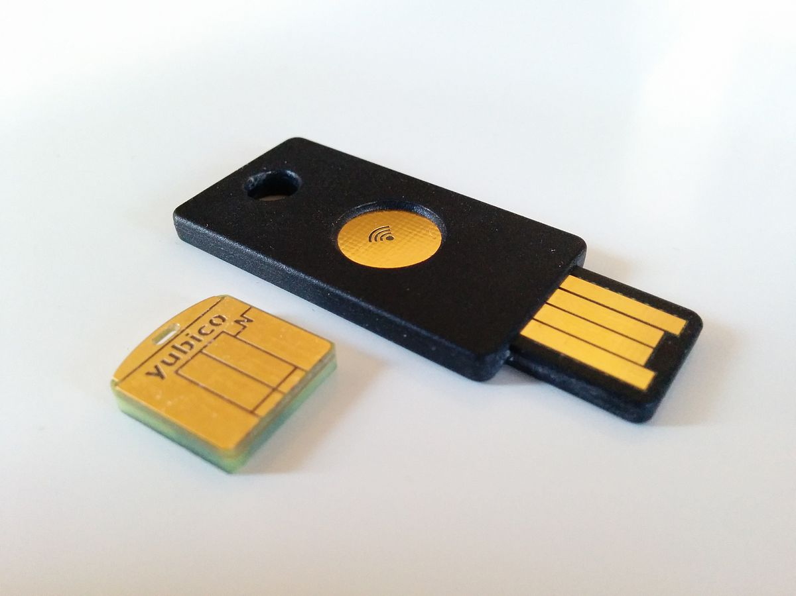
Authentication Factors
Something you have
Notes:
.

Slide 6

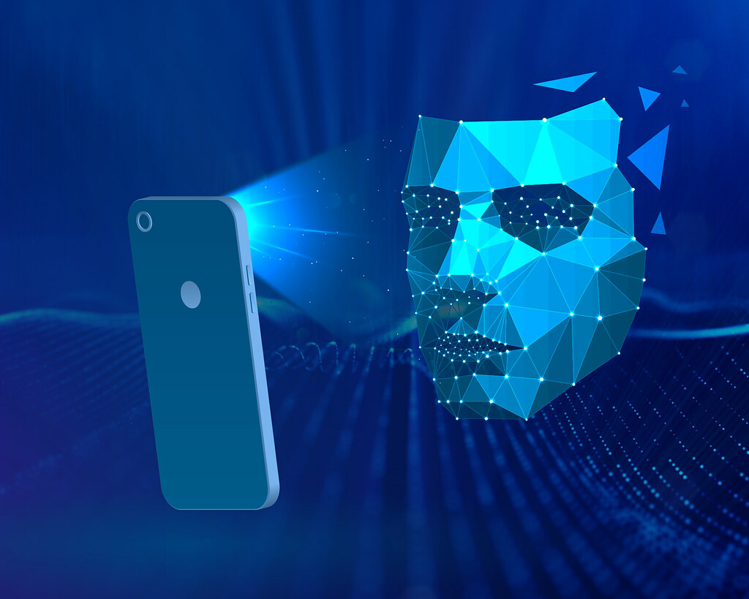
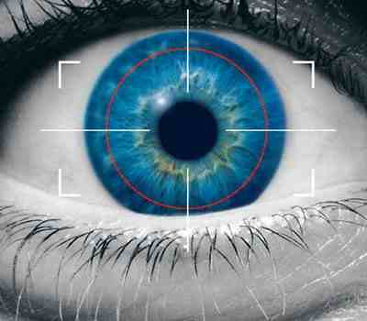
Authentication Factors
Something you are
Something you exhibit
Notes:
Cardiovascular pattern
Trait
Hybrid – Something you do, something you are, something you exhibt

Slide 7






Authentication Factors
Somewhere you are
10.10.0.201
Corporate
Network
Internet
172.16.145.230
192.168.8.101
Notes:
172.. employee’s house
10..employee’s friends house
192…..coffee ship

Slide 8
Identity, Authentication…
I am ….
Identity
I have proved it….
Authentication
Password
Your Name
Smartcard
Username
Biometrics
Identification Number
Notes:
.

Slide 9
Authorization
What can you access?
What are you allowed to do?
Read marketing documents
Log on to a workstation
Print to a printer
Notes:
.

Slide 10
Identity, Authentication, Authorization…
I am …. = Identity
What can you access or do? = Authorization
I have proved it….Authentication
Notes:
.

Slide 11
Accounting
I am …. = Identity
What can you access or do? = Authorization
I have proved it….Authentication
What have you accessed or done?
Event logs
Security logs
Audit logs
Notes:
.

Slide 12
IAAA
Identity = Who are you?…
Authentication = Prove it…
Authorization = What can you do?
Accounting = What did you do?
Notes:
.

Slide 13
Authentication Management
Password keys
YubiKey (external)
Mobile Devices (external)
Biometrics (internal)
FIDO U2F, UAF, CTAP and FIDO2
Notes:
Fast Identity Online (FIDO) Free Open Standards that allows for secure fast logins across websites and apps
FIDO Universal Second Factor (FIDO U2F)
FIDO Universal Authentication Framework
CTAP (W3C’s WebAuth + FIDO = FIDO2)
to trust, believe, confide in

Slide 14
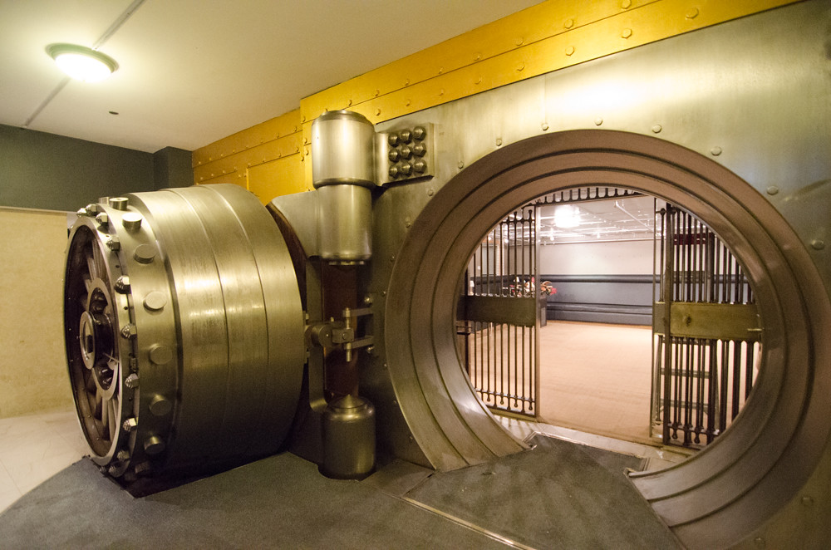
Authentication Management
Password Vaults
Online banking
School login
Online email
Company portal

Slide 15
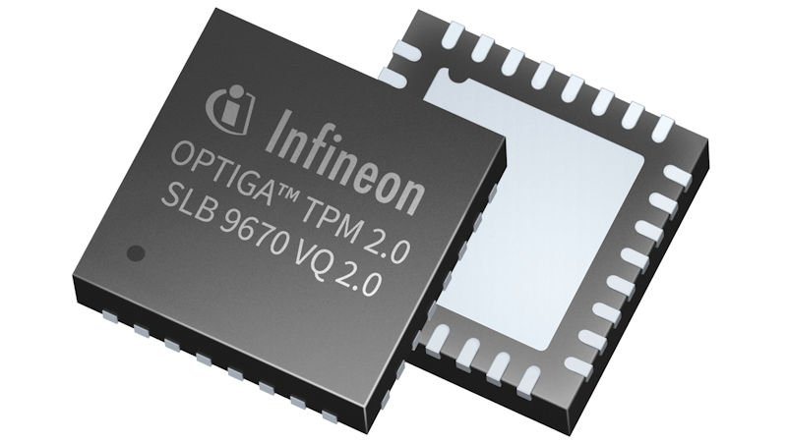
Authentication Management
Trusted Platform Modules
Embedded crypto-microcontroller
Stores authentication artifacts
Passwords
Encryption keys
Certificates
Platform configuration states
Notes:
Platform configuration states – if at boot time, unexpected or unauthorized changes have been made, access can be blocked to highly secure applications until the expected, authorized config state is returned.

Slide 16
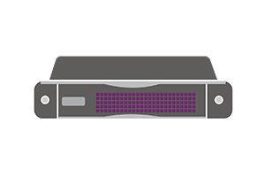
Authentication Management
Hardware Security Modules
Hardware-based appliance
Manages cryptographic information
Securing keys
Encryption and decryption
Authentication
Digital signing

